Slide 1
Use case diagram:
Search a recipe
client
Create a profile
Create recipe for the build in data
Schedule meals
Create recipe
Add ingredient
Edit recipes
Event
Daily, weekly, monthly, yearly
Delete client ingredients
Add ingredient for the build in data
Edit client recipes
Share recipe with another client
Edit ingredient
administrator
Cost information

Slide 2

Recipes
Ingredients
User interface guide:
Build in recipes
Add ingredient
Profile
Recipes
Ingredients
Schedule
Cart
Suggested recipes
List of user ingredient
User recipes
List of suggested ingredient
List of build-in ingredient
Schedule
Profile
Event
Edit profile
Daily schedule
Logout
Weekly schedule
Monthly schedule
Yearly schedule
When we click the shopping cart in the ingredients page and the recipes page, we want to pop up an option to insert quantities of the product we selected

Slide 3
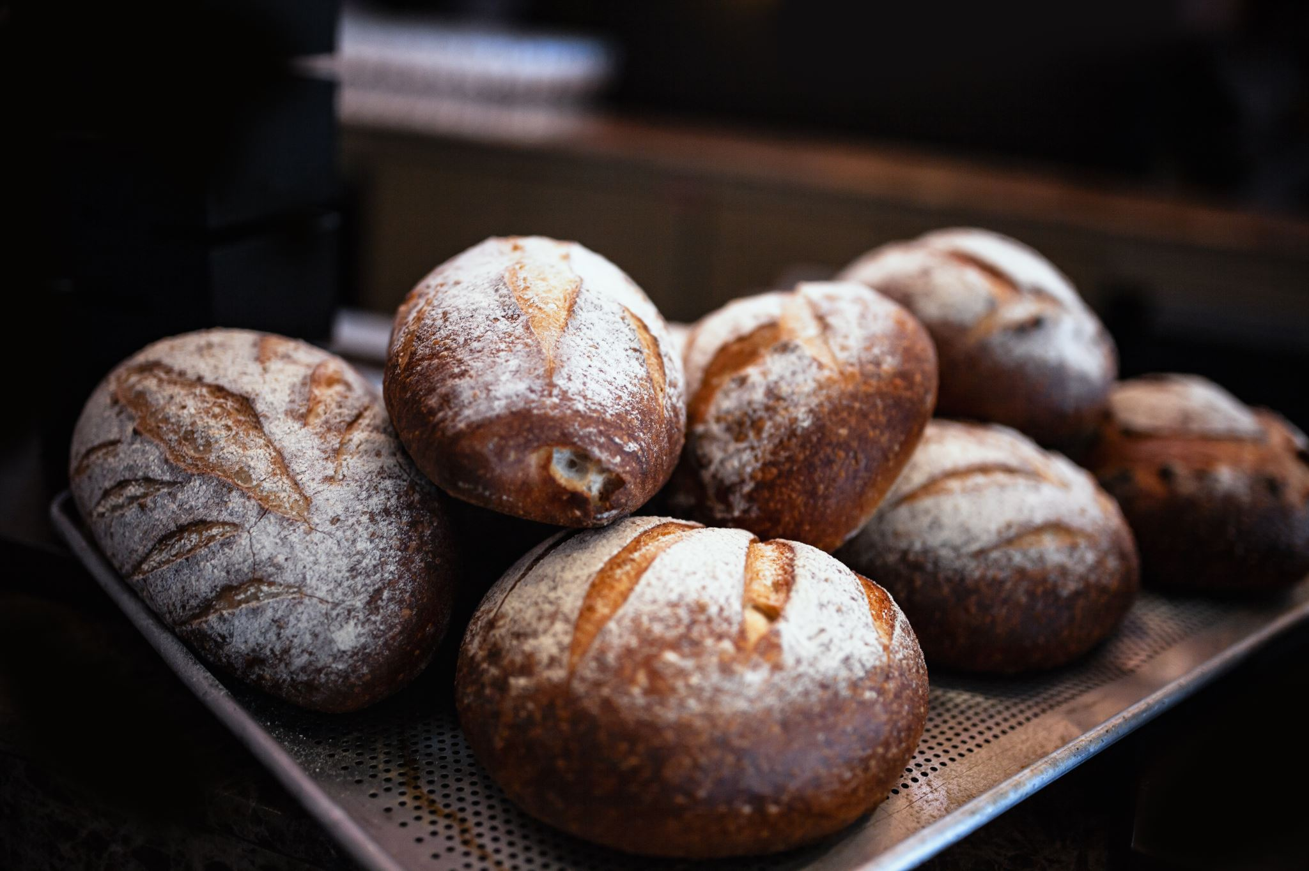

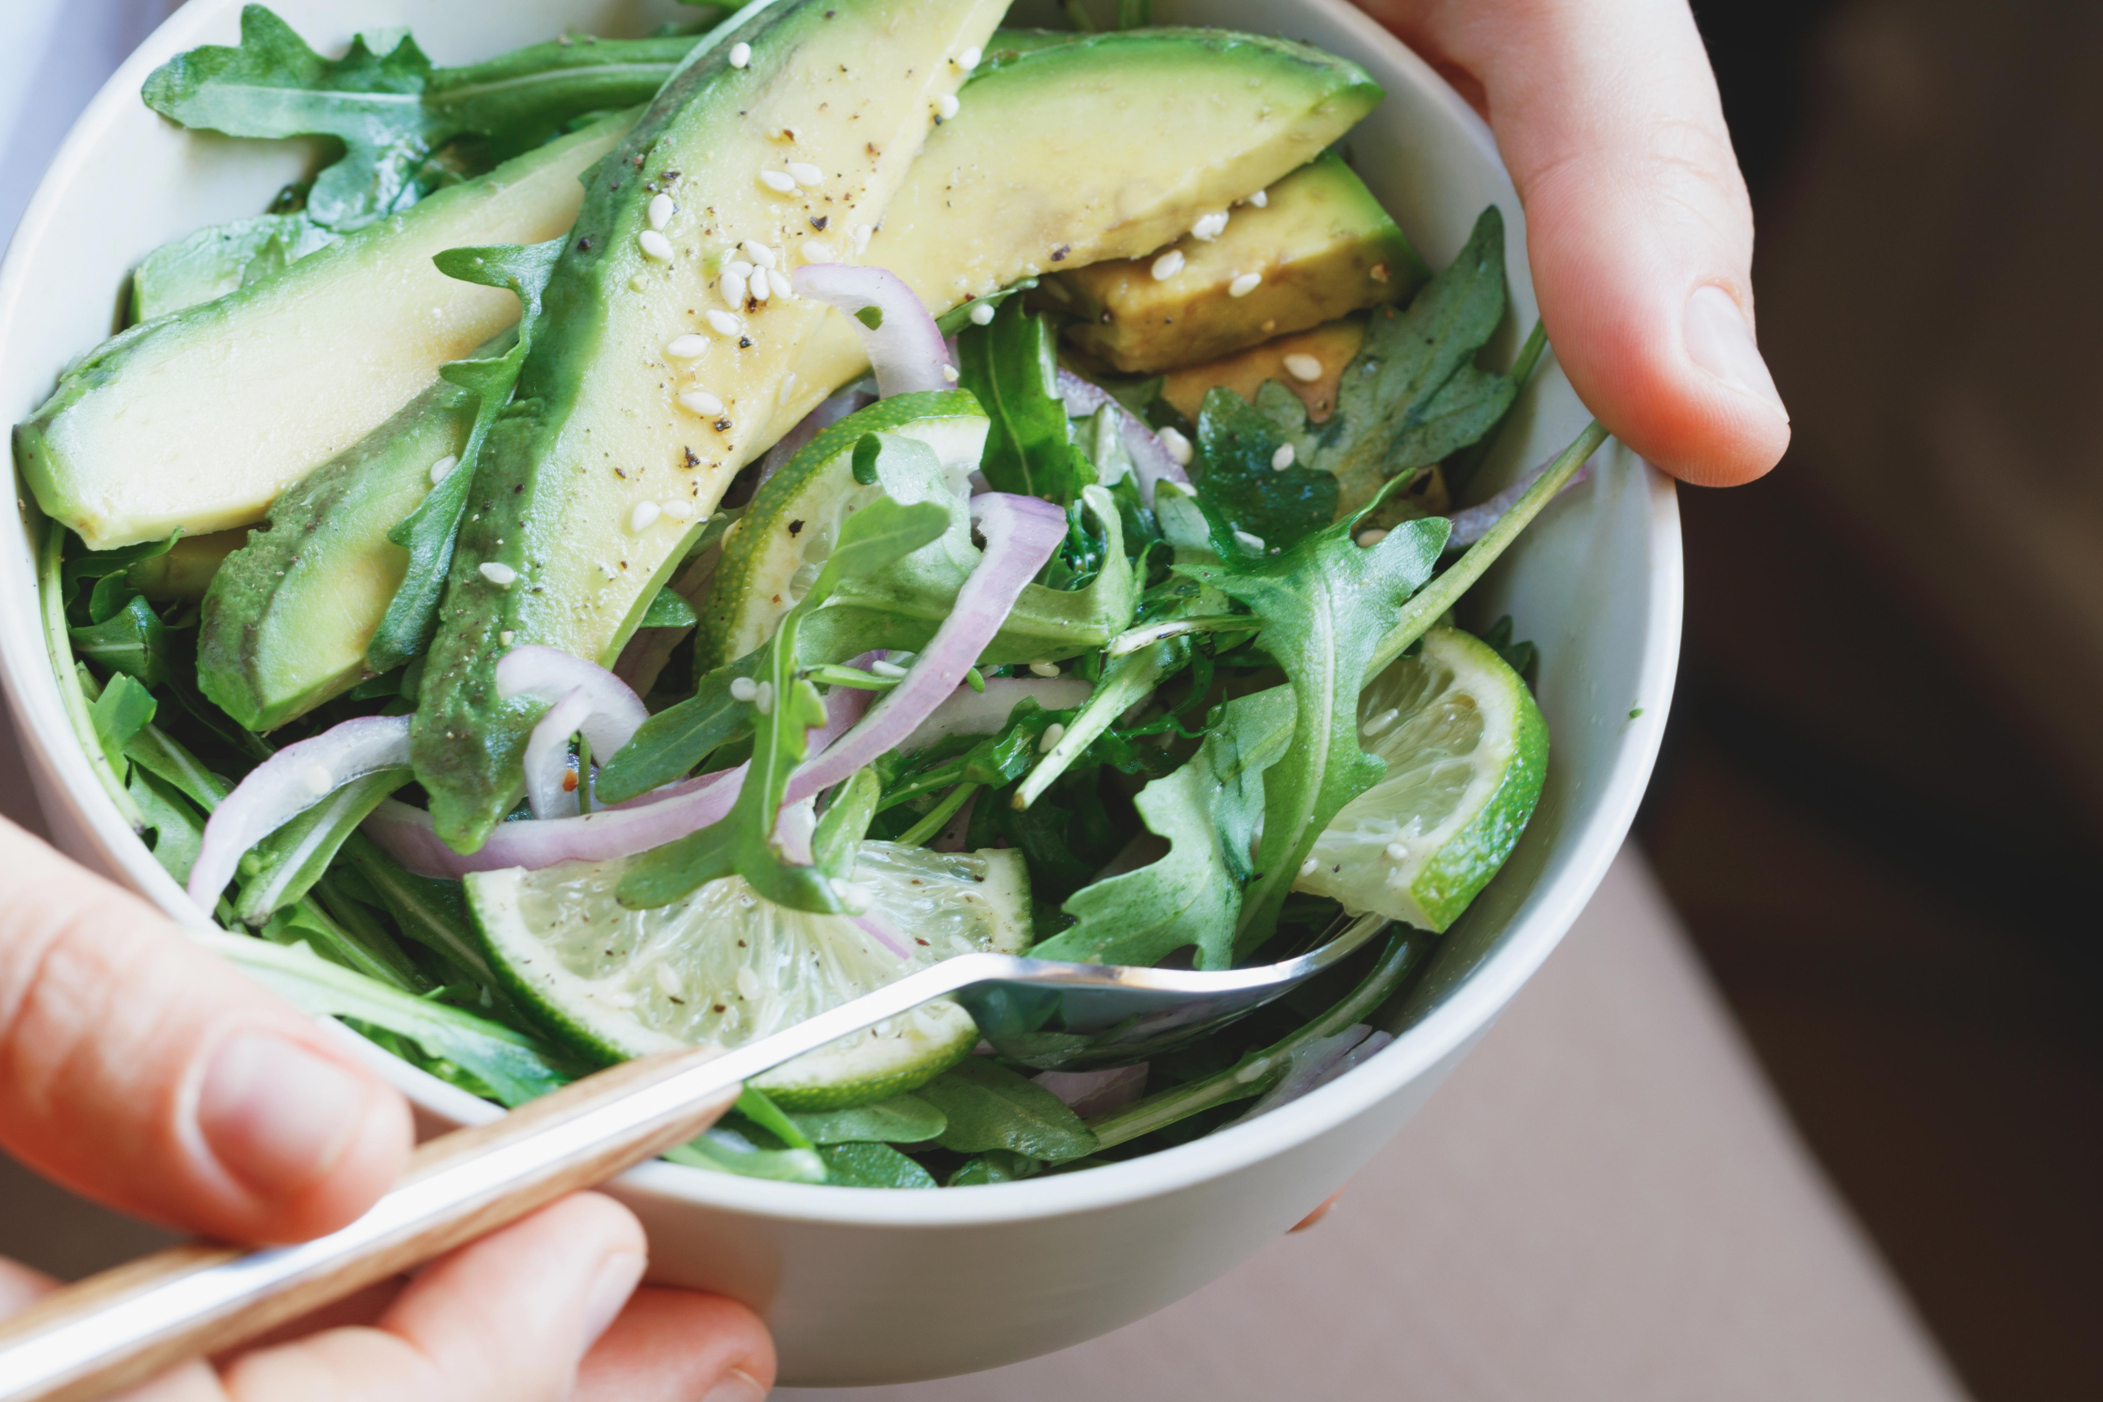

Build-in recipes
Suggested recipes
Profile
Recipes
Ingredients
Schedule
Cart
Profile
Recipes
Ingredients
Schedule
Cart
Build in recipes
Suggested recipes
Filter
Filter
Build in recipes
Suggested recipes
Bread
Ingredients
Creator
info
Bread
Ingredients
Salamone sushi
Ingredients
Creator
info
Salamone sushi
Ingredients
Green salad
Ingredients
Creator
info
Green salad
Ingredients
Muffins
Ingredients
Creator
info
Muffins
Ingredients

Slide 4


Profile
Recipes
Ingredients
Schedule
Cart
Create your recipe:
Profile
Recipes
Ingredients
Schedule
Cart
Create your recipe:
User recipes
Filter
Name of the recipe :
Kosher
User recipes
Create a recipe
Meat
Dairy
Parve
Mixed
Bread
Delete recipe
Insert a picture
Ingredients
Will open text dialog to insert instructions
Insert instruction
Salamone sushi
Delete recipe
1….
Number of portions that we will receive :
Ingredients
Insert Nutritious value
Beef
Tofu
Milk
……..
……..
-Add an ingredient to the system
Green salad
Delete recipe
List the ingredients
Ingredients
Label to show the cost of the recipe
Muffins
Delete recipe
I would like to share my recipe
Ingredients
I would like to share my information
Save

Slide 5



We are directed to this page after we click “Ingredients” from the recipes page
Profile
Recipes
Ingredients
Schedule
Cart
The number of portions we will receive from making that recipe
Ingredients for : “Salamone sushi”
Number of portions : 5
Parve
Nutritious value
Total cost
Ingredients :
Rice – 750 gram
The cost
Carrot – 150 gram
The cost
The cost
This will be a button that by clicking it – it will open a dialog showing the nutritious value for the entire recipe like amount of protein, carbs, fat
Salamone – 500 gram
Instruction :
*** Here will be presented how to make the dish step by step” ***

Slide 6
Add ingredient:
Profile
Recipes
Ingredients
Schedule
Cart
Add ingredient
Add an ingredient :
Name of the ingredient :
Type of meal
This is a button that will open a text dialog that the user will insert the nutritious value of the ingredient
Meat
Dairy
Parve
Gluten free
Insert a picture
A text dialog will be open in order to write how to store the ingredient in big quantities
The cost of the ingredient per 100 gram:
Nutritious value
Season
To list the season that we can get that ingredient
Winter, autumn, summer, spring, any (in all).
How to store
I would like to share my ingredient
I would like to share my information
Save

Slide 7




List of client ingredient:
Profile
Recipes
Ingredients
Schedule
Cart
We will direct the user to add ingredient page
List of user ingredients
Filter
User ingredients:
Add an ingredient
Eggplant
Information
Delete ingredient
Filter- meat, diary, parve, gluten free
Avocado
Information
Delete ingredient
Strawberry
Information
Delete ingredient
We cannot delete ingredients that are build-in in the system
Banana
Information
Delete ingredient

Slide 8
Build-in ingredients
Shared ingredients
Profile
Schedule
Cart
Profile
Recipes
Ingredients
Schedule
Cart
Recipes
Ingredients
Build-in ingredients:
shared ingredients:
Filter
Filter
Build-in ingredients:
Shared ingredients:
Eggplant
Information
Eggplant
Creator
info
Information
Avocado
Information
Avocado
Creator
info
Information
Strawberry
Information
Strawberry
Creator
info
Information
Banana
Information
Banana
Creator
info
Information

Slide 9




Event
Create an event
Profile
Recipes
Ingredients
Schedule
Cart
Profile
Recipes
Ingredients
Schedule
Cart
Event
Event
Event
Create an event
Create your event :
Pizza night
Information
Delete Event
Event name:
Calendar
Purim party
Information
Delete Event
Insert a picture:
Sivan’s birthday
Information
Delete Event
List the recipes
 | price | quantity | name | picture
 | 12.5 $ | 5 | Salamone sushi
 | 22$ | 3 | Muffins
Elad’s birthday
Information
Delete Event
info
info
Total price 34.5$
Save

Slide 10

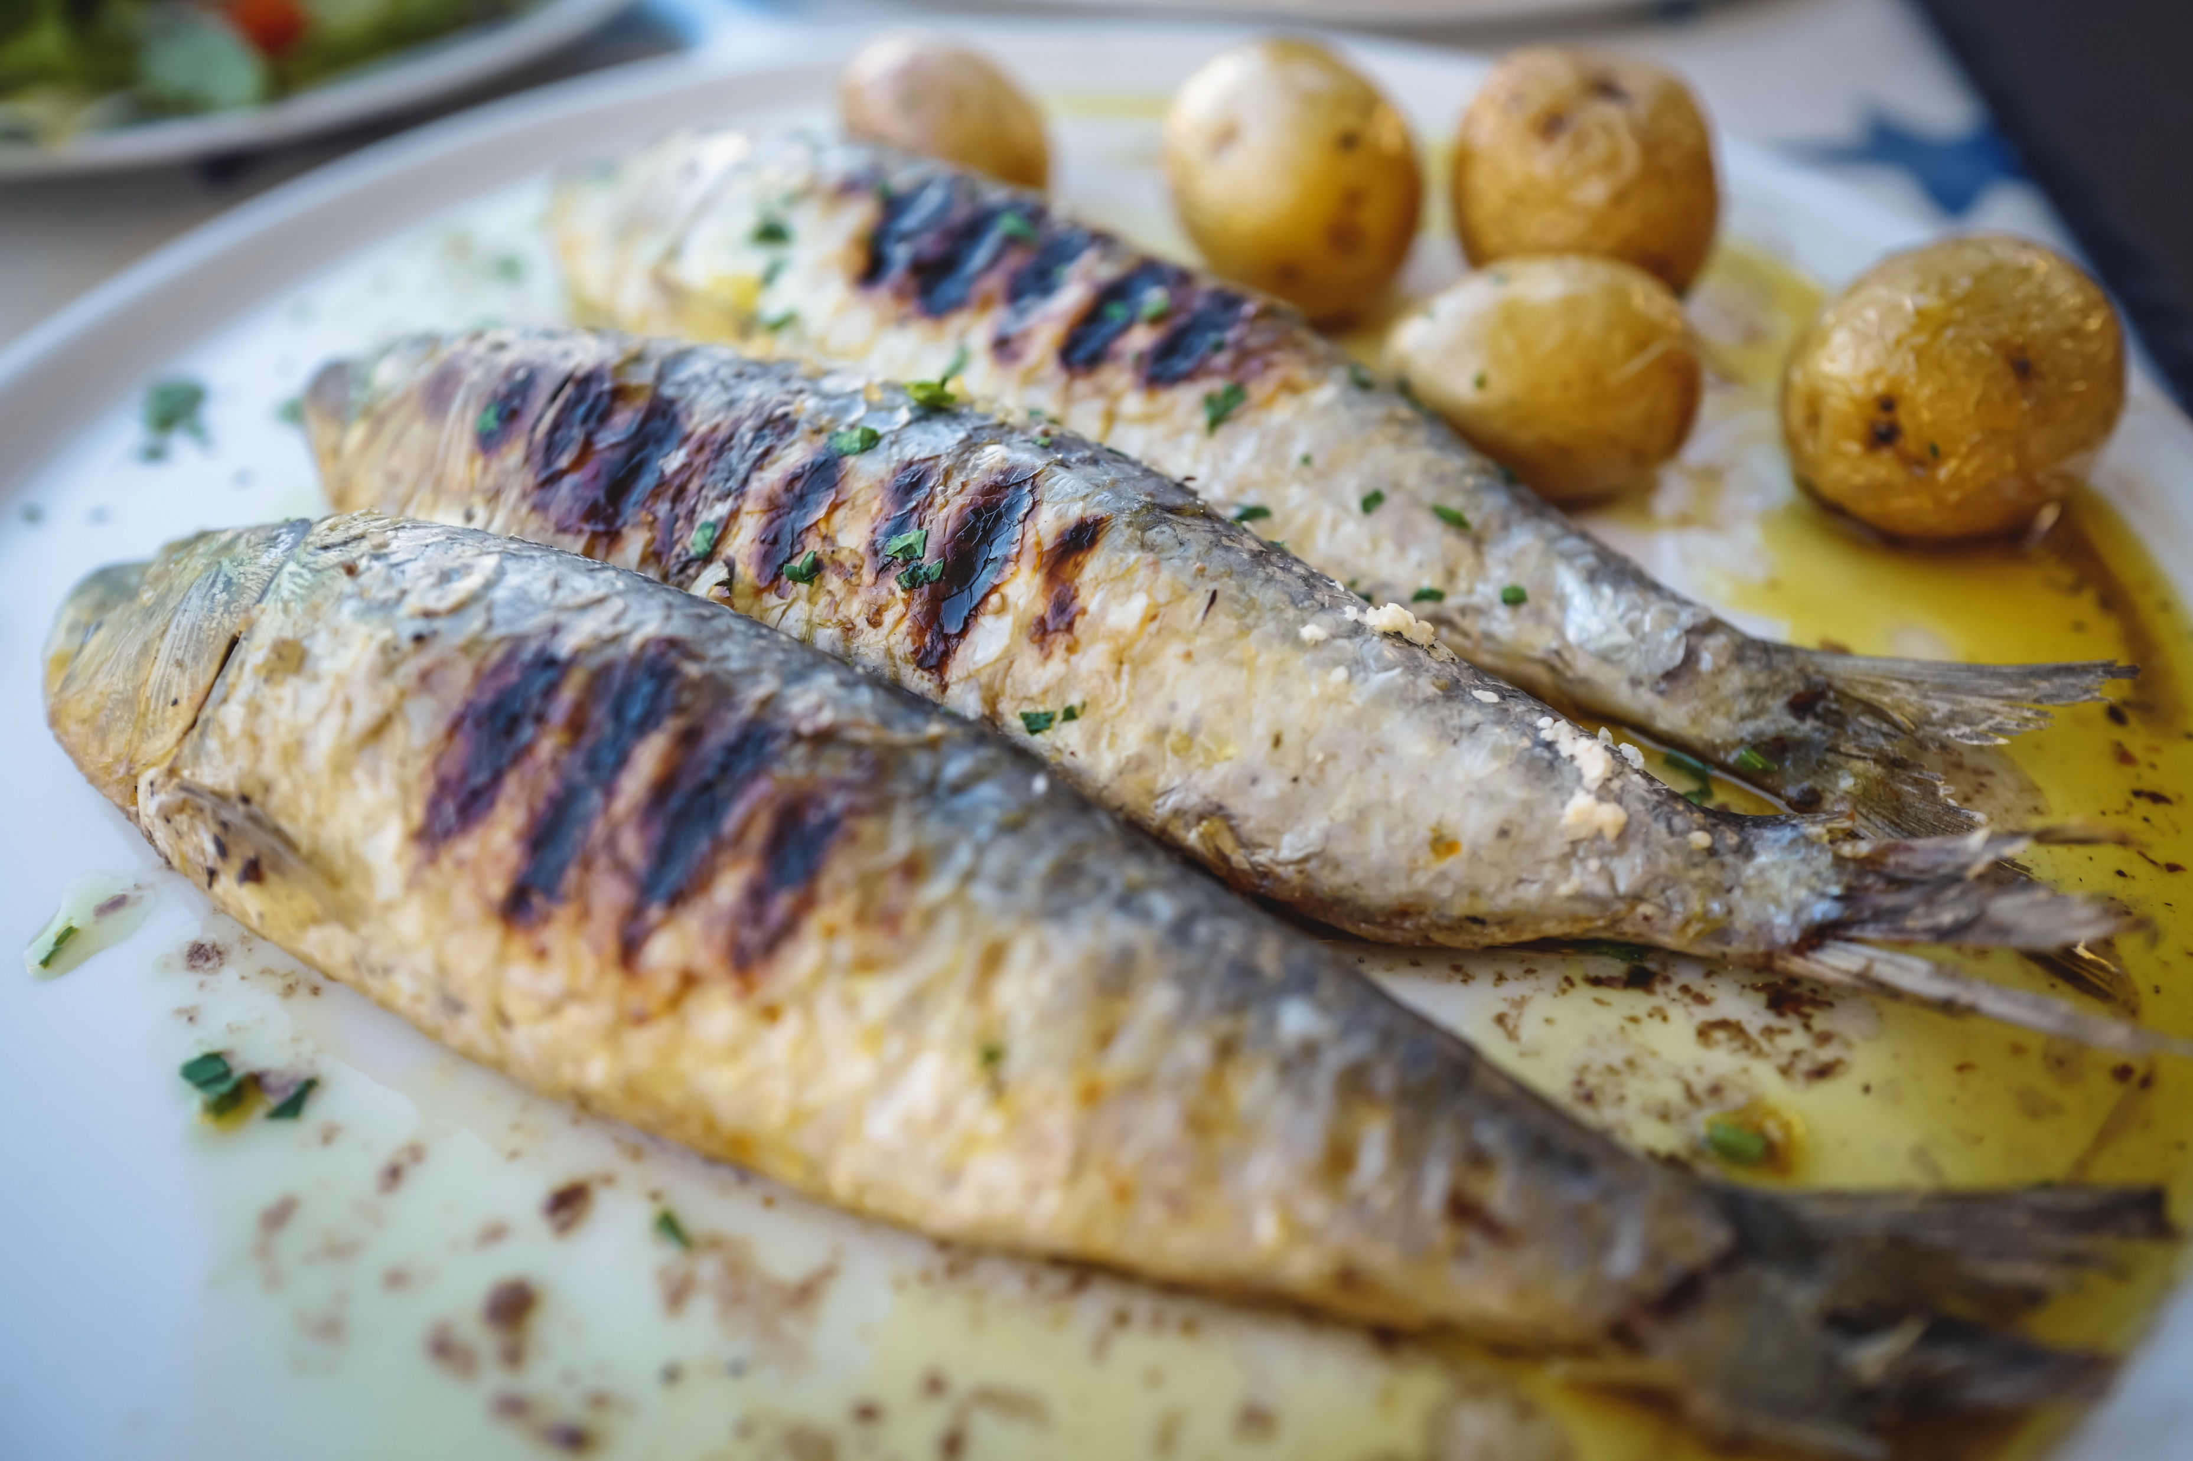
Daily schedule
Create daily schedule
Profile
Recipes
Ingredients
Schedule
Cart
Profile
Recipes
Ingredients
Schedule
Cart
Daily schedule
Daily schedule
Daily schedule
Create daily plan
Create your daily schedule :
Option 1
Information
Delete
Breakfast:
List the recipes
Option 2
Information
Delete
Lunch:
List the recipes
Dinner:
List the recipes
Option 3
Information
Delete
 | price | name | picture | category
 | 5.25$ | Berries corn flex |  | breakfast
 | 3.75$ | Salamone sushi |  | lunch
 | 10$ | fish |  | dinner
info
Option 4
Information
Delete
info
info
Total price 29$
Save

Slide 11
Weekly schedule
Create Weekly schedule
Profile
Recipes
Ingredients
Schedule
Cart
Profile
Recipes
Ingredients
Schedule
Cart
weekly schedule
weekly schedule
Weekly schedule
Create weekly plan
Create your weekly schedule :
Option 1
Information
Delete
Create / pick from daily
Sunday:
Saturday:
Create / pick from daily
Option 2
Information
Delete
 | price | category
 | 23$ | Sunday
….. | …. | ….
 | 32.5$ | Saturday
Option 3
Information
Delete
info
Option 4
Information
Delete
info
Total price : X
Save

Slide 12
Monthly schedule
Create Monthly schedule
Profile
Recipes
Ingredients
Schedule
Cart
Profile
Recipes
Ingredients
Schedule
Cart
Monthly schedule
Monthly schedule
Monthly schedule
Create monthly plan
Create your monthly schedule :
Option 1
Information
Delete
Create / pick from weekly
Week 1:
Week 4:
Create / pick from weekly
Option 2
Information
Delete
 | price | category
 | 213$ | Week 1
….. | …. | ….
 | 122.5$ | Week 4
Option 3
Information
Delete
info
Option 4
Information
Delete
info
Total price : X
Save

Slide 13
Yearly schedule
Create yearly schedule
Profile
Recipes
Ingredients
Schedule
Cart
Profile
Recipes
Ingredients
Schedule
Cart
Yearly schedule
Yearly schedule
Yearly schedule
Create Yearly plan
Create your Yearly schedule :
Option 1
Information
Delete
Create / pick from monthly
month 1:
month 12:
Create / pick from monthly
Option 2
Information
Delete
 | price | category
 | 613$ | Week 1
….. | …. | ….
 | 978.30$ | Week 4
Option 3
Information
Delete
info
Option 4
Information
Delete
info
Total price : X
Save

